Slide 1
Java Data Structures
Università di Modena e Reggio Emilia
Prof. Nicola Bicocchi (nicola.bicocchi@unimore.it)

Slide 2
Framework
The Java Collection Framework (JCF) is a set of classes and interfaces implementing commonly reusable data structures.
The JCF (package java.util) provides
interfaces defining functionalities
abstract classes for shared code aggregation
concrete classes implementing functionalities
algorithms (java.util.Collections)

Slide 3
Key Concepts
Resizable Array
Linked List
Balanced Tree
Hash Table

Slide 4
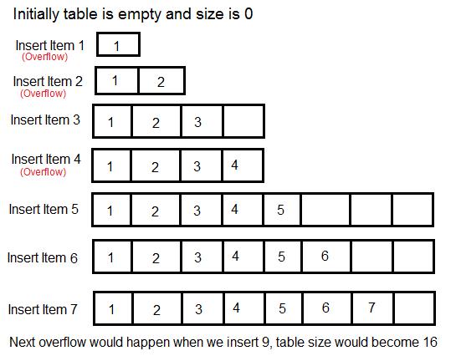
Resizable Array ~O(n)

Slide 5
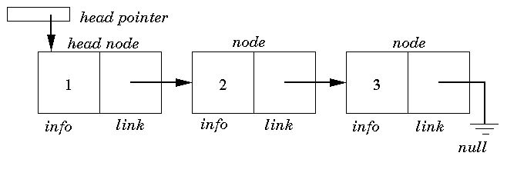
Linked List ~O(n)

Slide 6
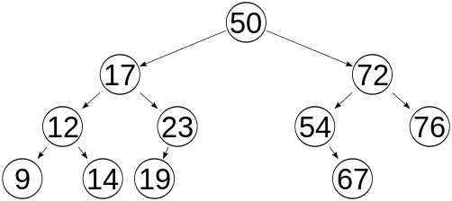
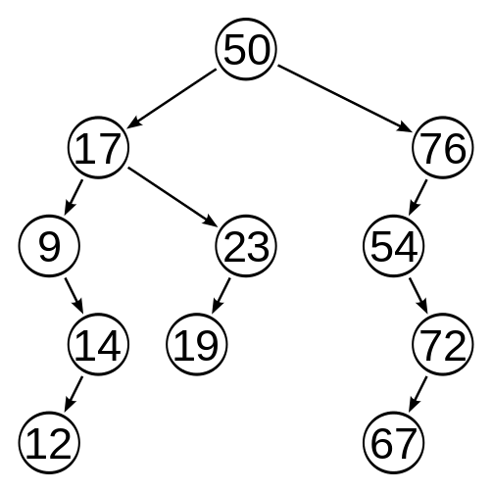
Balanced Tree ~O(log(n))
* A binary tree is balanced if, for each node it holds that, the number of inner nodes in the left subtree and the number of inner nodes in the right subtree differ by at most 1. A binary tree is balanced if for any two leaves the difference of the depth is at most 1.

Slide 7
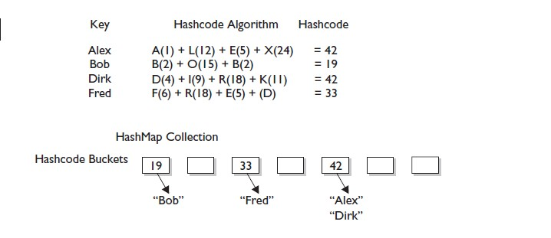
Hash Table ~O(1)

Slide 8
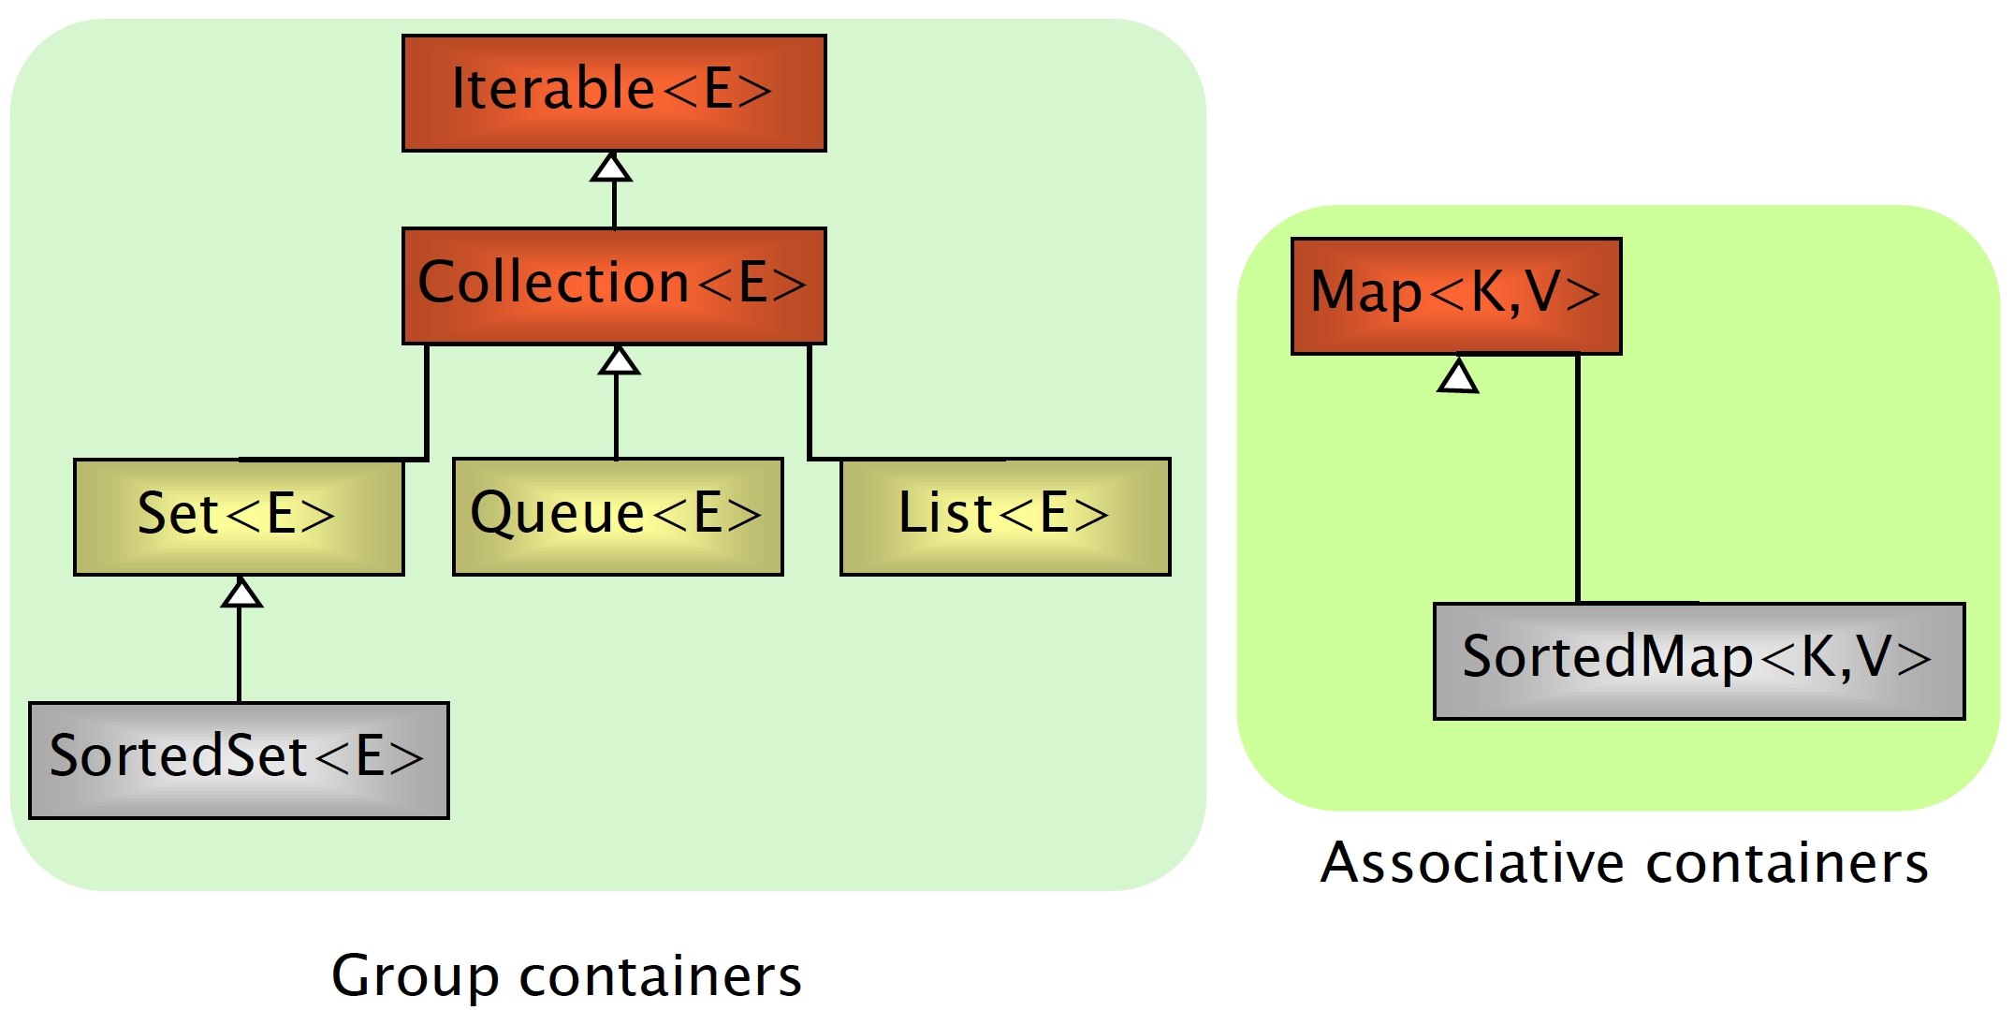
Interfaces

Slide 9
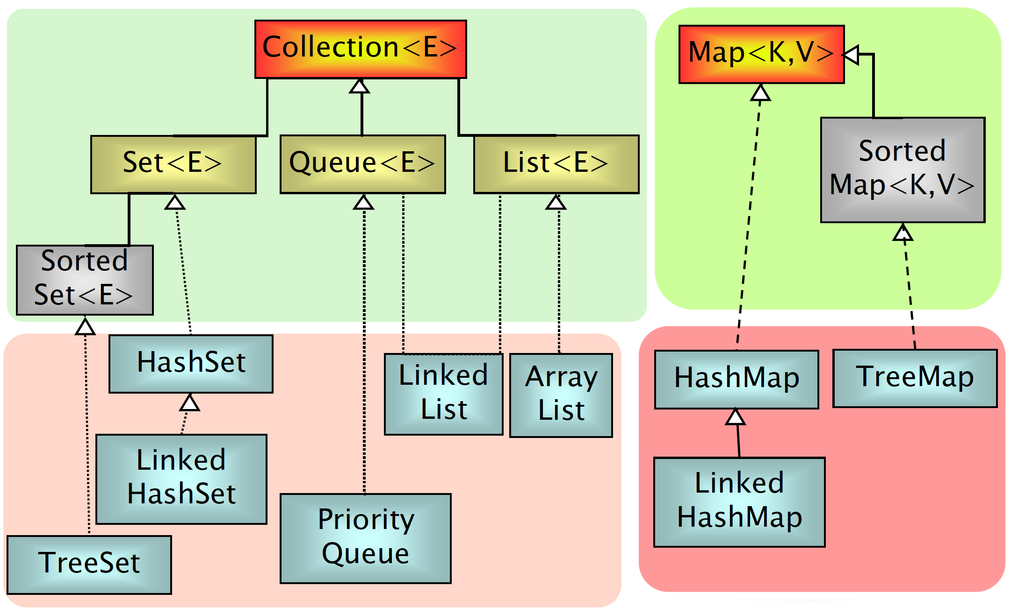
Implementations

Slide 10
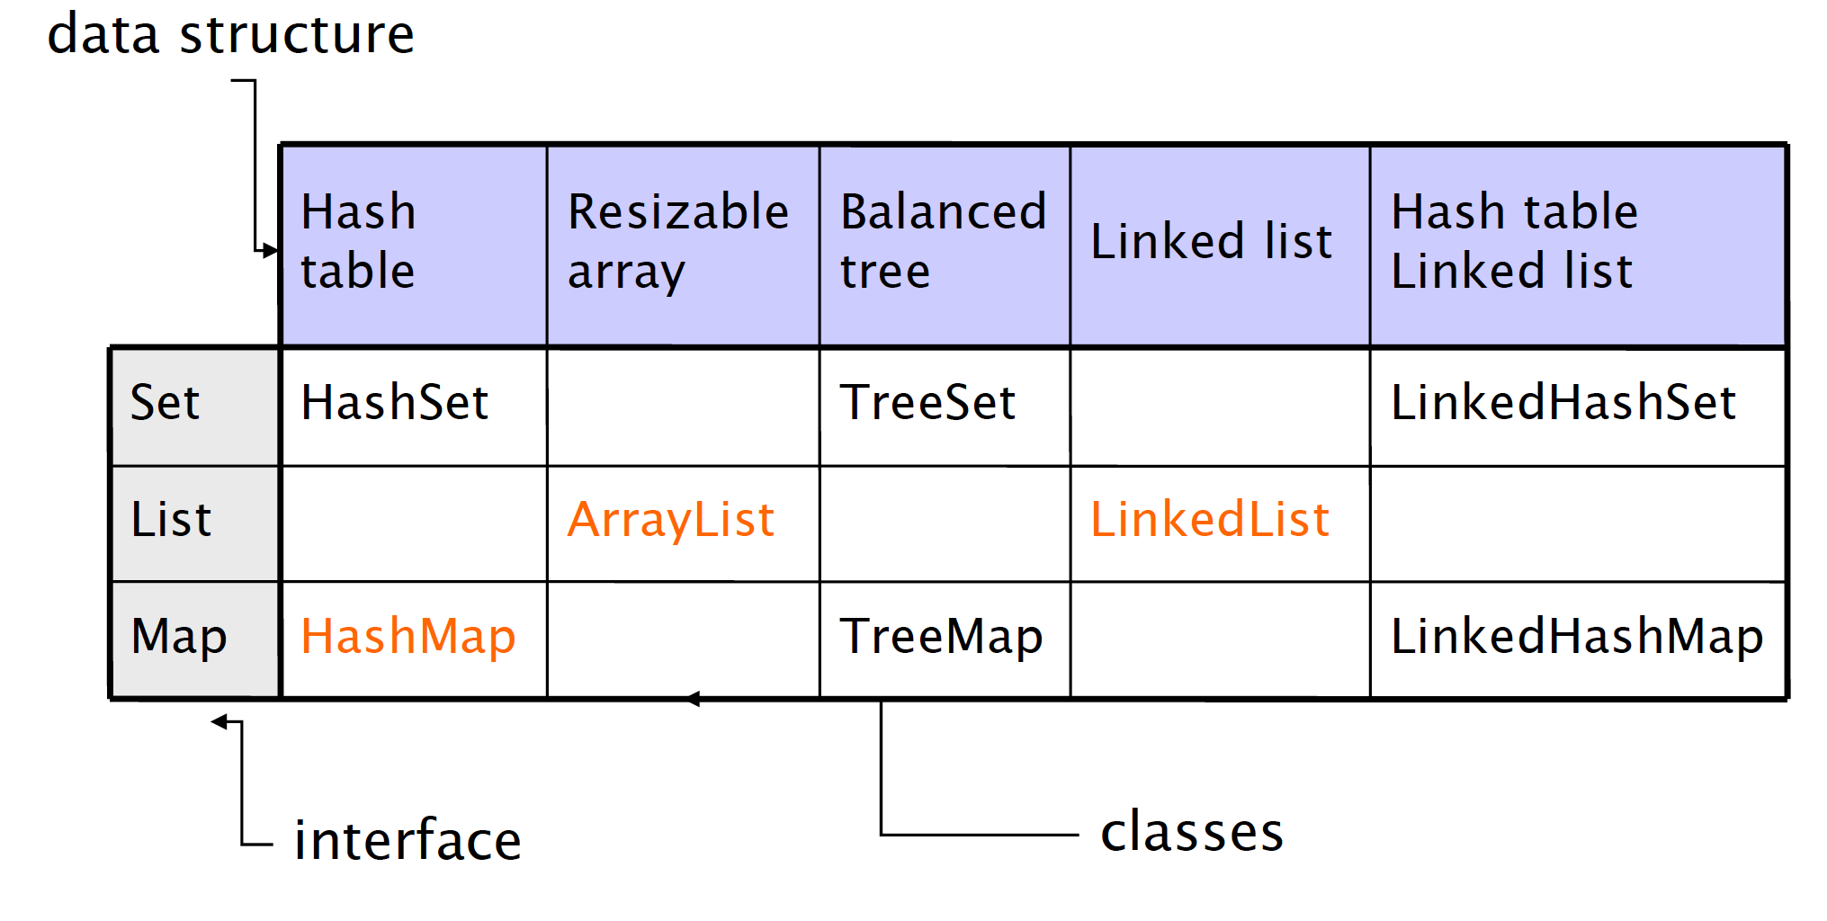
Internals

Slide 11
Iterable and Iterator Interfaces
The Iterable interface (java.lang.Iterable) is the root interface of the Java collection framework. Iterable, literally, means that “can be iterated”.
Technically, it means that an Iterator can be returned. Iterable objects (objects implementing the iterable interface) can be used with the for-each loop
public interface Iterable<T> {
Iterator<T> iterator();
}
List<Object> l = new ArrayList<Object>();
for(Object o : l){
//do something;
}
The Iterator interface extracts the traversal behaviour of a collection into a separate object called an iterator.
https://refactoring.guru/design-patterns/iterator
public interface Iterator<T> {
boolean hasNext()
T next()
void remove()
}
ArrayList<Object> l = new ArrayList<Object>();
for (Iterator<Object> i = l.iterator(); i.hasNext();) {
Object o = i.next();
// do something
}

Slide 12
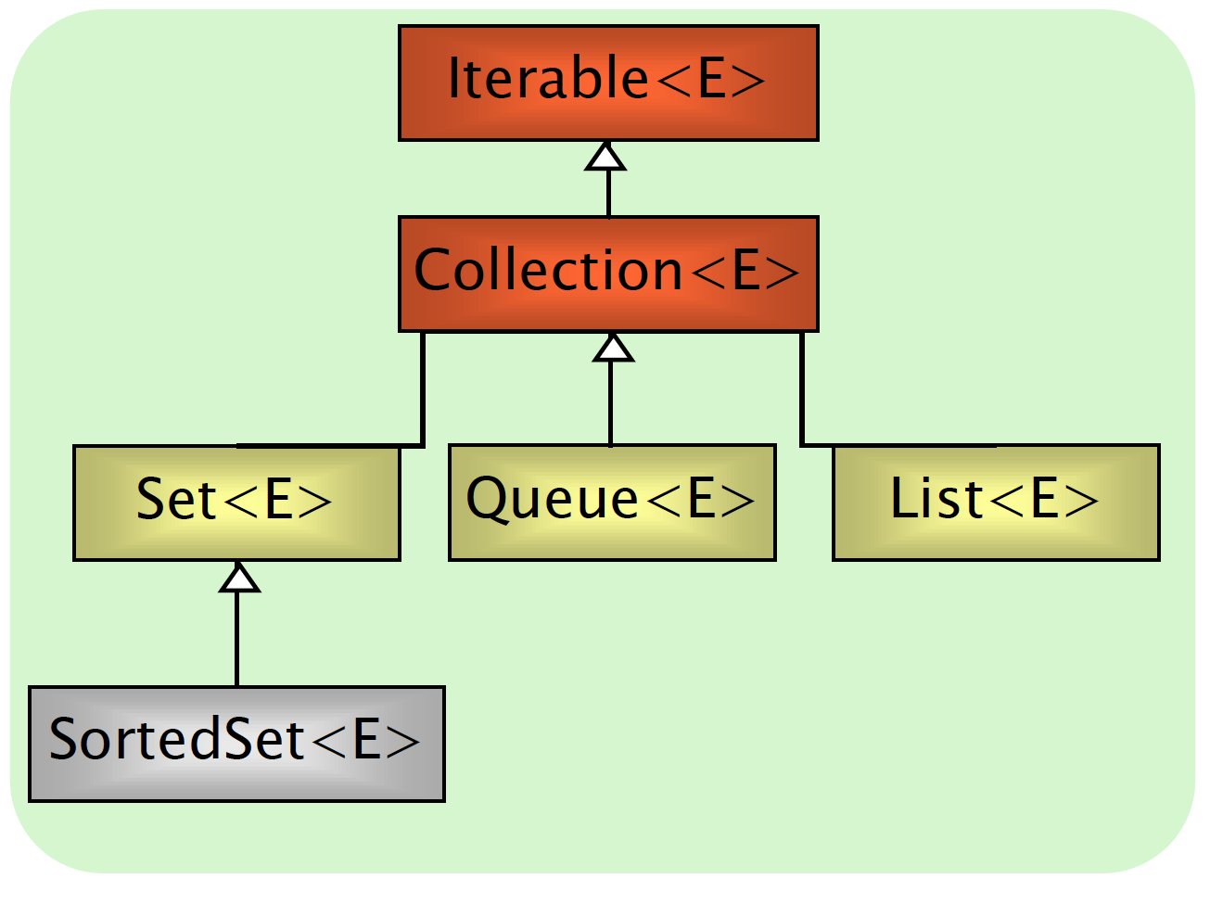
Collection Interface
Group of elements (references to objects)
It is not specified whether they are
Ordered / not ordered
Duplicated / not duplicated
Common constructors
Collection()
Collection(Collection c)

Slide 13
Collection Interface
int size()
boolean isEmpty()
boolean contains(Object element)
boolean containsAll(Collection c)
boolean add(Object element)
boolean addAll(Collection c)
boolean remove(Object element)
boolean removeAll(Collection c)
void clear()
Object[] toArray()
Iterator iterator()

Slide 14
List Interface
Can contain duplicate elements
Insertion order is preserved
User can select arbitrary insertion points
Elements can be accessed by position

Slide 15
List additional methods
Object get(int index)
Object set(int index, Object o)
Object remove(int index)
void add(int index, Object o)
boolean addAll(int index, Collection c)
int indexOf(Object o)
int lastIndexOf(Object o)
List subList(int fromIndex, int toIndex)

Slide 16
List Initialization
/* plain, simple, long */
List<Integer> l = new ArrayList<Integer>();
l.add(14);
l.add(73);
l.add(18);
…
/* more compact version (mutable)*/
List<Integer> l = new ArrayList<>(Arrays.asList(14, 73, 18));
List<Integer> l = new ArrayList<>(List.of(14, 73, 18));
/* more compact version (immutable)*/
List<Integer> l = List.of(14, 73, 18);

Slide 17
List Implementations
Decoupling references from actual objects allows to change implementation (and related performance!) by changing a single line of code!
List<Car> garage = new LinkedList<Car>();
//List<Car> garage = new ArrayList<Car>();
garage.add(new Car());
garage.add(new SDCar());
garage.add(new SDCar());
garage.add(new Car());
for(Car c : garage) {
c.turnOn();
}

Slide 18
List Implementations
ArrayList implements List
get(index) -> Constant time
add(index, obj) -> Linear time
LinkedList implements List, Queue
get(index) -> Linear time
add(index, obj) -> Linear time (but more lightweight)

Slide 19
List Implementations
ArrayList retrieval: approx O(1)
ArrayList insertion(end): approx O(1)
ArrayList insertion(beginning): approx O(n)

Slide 20
List Implementations
LinkedList retrieval: approx O(n)
LinkedList insertion(end): approx O(n)
LinkedList insertion(beginning): approx O(1)

Slide 21
Set Interface
Contains no methods other than those inherited from Collection
No duplicate elements are allowed

Slide 22
Set Implementations
HashSet implements Set
Hash tables as internal data structure (fast!)
Insertion order not preserved
LinkedHashSet extends HashSet
Insertion order preserved
TreeSet implements SortedSet (an extension of Set)
R-B trees as internal data structure (provide ordering)
User definable internal ordering TreeSet(Comparator c)
Slow when compared to hash-based implementations

Slide 23
HashSet Example
ArrayList<String> l = new ArrayList<>(
List.of(“Nicola”, “Agata”, “Marzia”, “Agata”));
Set<String> hs = new HashSet<>(l);
System.out.println(l);
[Nicola, Agata, Marzia, Agata]
System.out.println(hs);
[Marzia, Nicola, Agata]

Slide 24
LinkedHashSet Example
ArrayList<String> l = new ArrayList<>(
List.of(“Nicola”, “Agata”, “Marzia”, “Agata”));
Set<String> lhs = new LinkedHashSet<>(l);
System.out.println(l);
[Nicola, Agata, Marzia, Agata]
System.out.println(lhs);
[Nicola, Agata, Marzia]

Slide 25
TreeSet Example
ArrayList<String> l = new ArrayList<>(
List.of(“Nicola”, “Agata”, “Marzia”, “Agata”));
Set<String> ts = new TreeSet<>(l);
System.out.println(l);
[Nicola, Agata, Marzia, Agata]
System.out.println(ts);
[Agata, Marzia, Nicola]

Slide 26
TreeSet Internal Ordering
Depending on the constructor used, SortedSet implementations can use different orderings
TreeSet()
Natural ascending ordering
Elements must implement the Comparable Interface
TreeSet(Comparator c)
Ordering is defined by the Comparator c

Slide 27
Queue Interface
A collection designed for holding elements prior to processing
Provides additional insertion, extraction, and inspection operations. It also defines a head (first element) and a tail (last element)

Slide 28
Queue additional methods
boolean add(Object o)
/* return null on error */
Object peek() //retrieves, not removes
Object poll() //retrieves, and removes
/* throw an exception on error */
Object element() //retrieves, not removes
Object remove() //retrieves, and removes

Slide 29
Queue Implementations
LinkedList implements List, Queue
Insertion order conserved
Head is the first element of the list
FIFO (First-In-First-Out) policy
PriorityQueue implements Queue
Internal ordering policy. Default is natural ascending ordering, if defined. Can be modified by implementing the Comparable interface

Slide 30
Queue Example
ArrayList<Integer> l = new ArrayList<>(List.of(3, 1, 2));
Queue<Integer> fifo = new LinkedList<Integer>(l);
Queue<Integer> pqueue = new PriorityQueue<Integer>(l);
System.out.println(fifo.peek()); // 3
System.out.println(pqueue.peek()); // 1

Slide 31
PriorityQueue or TreeSet?!?
Similarities
Both provide O(log(N)) time complexity for adding, removing, and searching elements
Both provide elements in sorted order
Differences
TreeSet is a Set and doesn't allow a duplicate element, while PriorityQueue is a queue and doesn't have such restriction.
Another key difference between TreeSet and PriorityQueue is iteration order, though you can access elements from the head in a sorted order e.g. head always give you lowest or highest priority element depending upon your Comparable or Comparator implementation but iterator returned by PriorityQueue doesn't provide any ordering guarantee.

Slide 32
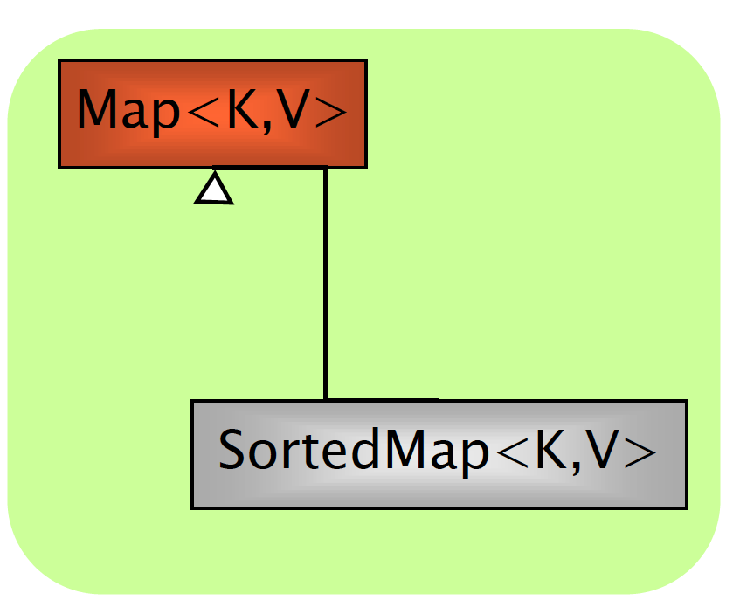
Map Interface
An object storing pairs of (key, value)
(e.g., key: surname, value: phone number)
Keys and values must be objects
Keys must be unique
Common constructors:
Map()
Map(Map m)

Slide 33
Map Interface
Object put(Object key, Object value)
Object get(Object key)
Object remove(Object key)
boolean containsKey(Object key)
boolean containsValue(Object value)
public Set keySet()
public Collection values()
int size()
boolean isEmpty()
void clear()

Slide 34
HashMap
Get/set takes constant time (without considering collisions)
Automatic re-allocation when load factor reached
Constructor optional arguments
load factor(default = .75)
initial capacity(default = 16)

Slide 35
Map Example I
Map<String, Integer> m = new HashMap<>();
m.put(“Agata”, 2);
m.put(“Marzia”, 3);
m.put(“Agata”, 4);
m.put(“Nicola”, 1);
/* more compact version */
Map<String, Integer> m = new HashMap<>(
Map.of(“Agata”, 2, “Marzia”, 3, “Agata”, 4, “Nicola”, 1));
/* immutable version */
Map<String, Integer> m =
Map.of(“Agata”, 2, “Marzia”, 3, “Agata”, 4, “Nicola”, 1);

Slide 36
Map Implementations
HashMap implements Map
Hash tables as internal data structure (fast!)
Insertion order not preserved
LinkedHashMap extends HashMap
Insertion order preserved
TreeMap implements SortedMap
R-B trees as internal data structure
User definable internal ordering
Slow when compared to hash-based implementations
* Similar to Set implementations
Map<Integer, String> src; src = new HashMap<>(); src.put(77, "Nicola"); src.put(17, "Marzia"); src.put(22, "Agata"); System.out.println(src);
// {17=Marzia, 22=Agata, 77=Nicola} src = new LinkedHashMap<>(); src.put(77, "Nicola"); src.put(17, "Marzia"); src.put(22, "Agata"); System.out.println(src);
// {77=Nicola, 17=Marzia, 22=Agata} src = new TreeMap<>(); src.put(77, "Nicola"); src.put(17, "Marzia"); src.put(22, "Agata"); System.out.println(src);
// {17=Marzia, 22=Agata, 77=Nicola}

Slide 37
Map Example II
Map<String, Integer> m = new HashMap<String, Integer>();
…
// looping keys and accessing values
Set<String> keys = m.keySet();
for(String key : keys) {
System.out.println(key + " -> " + m.get(key));
}
// contains key
if (m.containsKey(key)) {
System.out.println(m.get(key));
}
// looping values
List<Integer> values = m.values();
for(int value : values) {
System.out.println(value);
}

Slide 38
Collections and Iterators
It is unsafe to modify (adding or removing elements) a Collection while iterating over it!
List<Double> l = new LinkedList<Double>(
List.of(10.8, 11.1, 13.2, 30.2));
int count = 0;
for (double i : l) {
if (count == 1) l.remove(count);
if (count == 2) l.add(22.3);
count++;
} // Run-time error! We modify the list while iterating

Slide 39
Iterator and ListIterator Interfaces
Interface Iterator provides a transparent means for cycling through all elements of a Collection (forward only) and removing elements
boolean hasNext()
Object next()
void remove()
Interface ListIterator provides a transparent means for cycling through all elements of a Collection (forward and backward) and removing and adding elements
boolean hasNext()
boolean hasPrevious()
object next()
object previous()
void add()
void set()
void remove()
int nextIndex()
int previousIndex()

Slide 40
Iterator and ListIterator Interfaces
List<Double> l = new LinkedList<Double>(
List.of(10.8, 11.1, 13.2, 30.2));
int count = 0;
for (Iterator<Double> i = l.iterator(); i.hasNext();) {
double d = i.next();
if (count == 1) i.remove();
count++;
}
List<Double> l = new LinkedList<Double>(
List.of(10.8, 11.1, 13.2, 30.2));
int count = 0;
for (ListIterator<Double> i = l.listIterator(); i.hasNext();) {
double d = i.next();
if (count == 1) i.remove();
if (count == 2) i.add(22.3);
count++;
}

Slide 41
Iterations and Iterators
List<Person> pl = new ArrayList<Person>();
/* C style */
for (int i = 0; i < pl.size(); i++)
System.out.println(pl.get(i))
/* for-each style */
for (Person p : pl)
System.out.println(p);
/* iterator style */
for(Iterator<Person> i = pl.iterator(); i.hasNext();) {
Person p = i.next();
System.out.println(p);
}
/* while style */
Iterator i = pl.iterator();
while (i.hasNext())
System.out.println((Person)i.next());

Slide 42
java.util.Collections
Alter-ego of java.util.Arrays for Collections
This class contains various methods for manipulating arrays such as sorting, searching, filling, printing or being viewed as an array
sort() - merge sort implementation, n log(n)
binarySearch() - requires ordered collection
shuffle() - unsort
reverse() - requires ordered collection
rotate() – rotate elements of a given distance
min(), max() - in a collection

Slide 43
Algorithms
ArrayList<String> l = new ArrayList<String>(
List.of("Nicola", "Agata", "Marzia", "Agata"));
Collections.sort(l);
System.out.println(l); // [Agata, Agata, Marzia, Nicola]
Collections.reverse(l);
System.out.println(l); // [Nicola, Marzia, Agata, Agata]
Collections.shuffle(l);
System.out.println(l); // [Marzia, Agata, Agata, Nicola]
Collections.rotate(l, 1);
System.out.println(l); // [Nicola, Marzia, Agata, Agata]

Slide 44
Algorithms
ArrayList<String> l = new ArrayList<String>(
List.of("Nicola", "Agata", "Marzia", "Agata"));
Collections.sort(l);
System.out.println(l); // [Agata, Agata, Marzia, Nicola]
Collections.binarySearch(l, "Nicola"); // 3
Collections.binarySearch(l, "Zuck")); // -5
The list must be sorted into ascending order according to the natural ordering of its elements (as by the sort(List) method) prior to making this call. If it is not sorted, the results are undefined.

Slide 45
Sorting Collections of Objects
For sorting collections of objects, the Comparable interface must be implemented for making objects comparable to each other.
The Comparable Interface is implemented by default in common types in packages java.lang and java.util
A collection of T can be sorted if T implements Comparable. The compareTo() method compares the object with the object passed as a parameter. Return value must be:
< 0 if this object precedes obj
== 0 if this object has the same position as obj
> 0 if this object follows obj
public interface Comparable<T> {
public int compareTo(T obj);
}
public interface Comparator<T> {
public int compare(T obj1, T obj2);
}

Slide 46
The Comparable Interface
class Person implements Comparable<Person> {
protected String name;
protected String lastname;
protected int age;
public int compareTo(Person p) {
// order by surname
return lastname.compareTo(p.lastname);
}
}
class Person implements Comparable<Person> {
protected String name;
protected String lastname;
protected int age;
public int compareTo(Person p) {
// order by surname
cmp = lastname.compareTo(p.lastname);
if (cmp == 0)
// if surnames are equal, order by name
cmp = firstname.compareTo(s.firstname);
return cmp;
}
}

Slide 47
The Comparator Interface
Given a class already implementing Comparable<E>, we can sort it using alternative orders using a Comparator<E>
public class SortByAge implements Comparator<Person> {
@Override
public int compare(Person o1, Person o2) {
return o1.age - o2.age;
}
}
class Person implements Comparable<Person> {
protected String name;
protected String lastname;
protected int age;
public int compareTo(Person p) {
return lastname.compareTo(p.lastname);
}
}
public static void main(String[] args) {
ArrayList<Person> l = new ArrayList<Person>();
l.add(new Person("Mario", "Rossi", 68));
l.add(new Person("Luca", "Bianchi", 28));
l.add(new Person("Carlo", "Antoni", 34));
// natural ordering (Comparable)
Collections.sort(l)
// special ordering (Comparator)
Collections.sort(l, new SortByAge());
// Comparator anonymous class
Collections.sort(l, new Comparator<Person>() {
@Override
public int compare(Person o1, Person o2) {
return o1.age - o2.age;
}
});
}

Slide 48
Wisdom Pills
Making messes is always slower than staying clean
Clean Architecture, Robert C. Martin
The only way to go fast, is to go well.
Clean Architecture, Robert C. Martin

